Slide 1
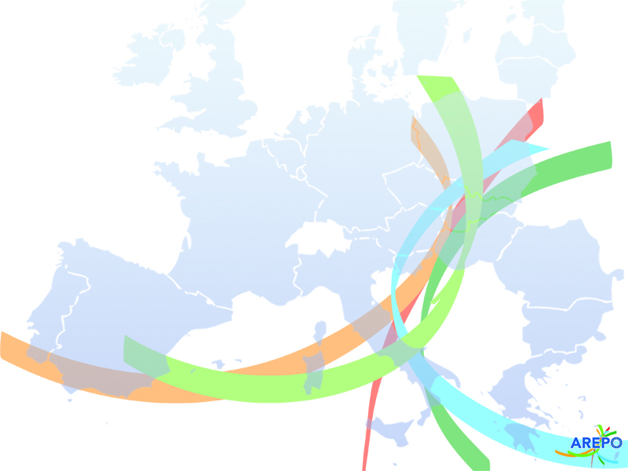
Update on EU projects
Anne CLERMONTELLE,
External consultant for AREPO in charge of EU projects

Slide 2
Ongoing EU projects

Slide 3


AGROSMARTglobal presentation
Interreg Sudoe 2014-2020 programme
Anne CLERMONTELLE
1st AREPO General Assembly of 2022
April 28, 2022, Brussels

Slide 4



What is AGROSMARTglobal?
AGROSMARTglobal is a 3.5-year project (2019 - 2023) involving 10 partners and coordinated by the Union of agri-food cooperatives of Galicia (AGACA), Spain.
Interreg Sudoe 2014-2020 programme
Objective: consolidate the space for promotion, intercooperation and competitiveness of agri-food cooperatives by developing advanced support tools to strengthen their positioning and internationalisation through the implementation of digital marketing strategies.
REFERENCE N°:
SOE3/P2/E0897
CALL:
3rd call 2018 of Interreg
Sudoe Programme
2014 – 2020
PRIORITY AXIS 2:
Promoting the competitiveness
and the internationalisation
of Southwest Europe SMEs
AGROSMARTglobal | Space for the competitiveness, promotion and intelligent international expansion of agri-food cooperatives in the Sudoe rural areas
Joint strategic plan for digital internationalisation of agri-food cooperatives
Technical consultancy for digital internationalisation
Joint education and training programme in digital strategies
Joint campaign for the promotion and positioning of cooperatives’ products
The European Commission support for the production of this publication does not constitute endorsement of the contents which reflects the views only of the authors, and the Commission cannot be held responsible for any use which may be made of the information contained therein.

Slide 5

AREPO’s contribution
Role of AREPO : promote and protect agricultural and agri-food products that benefit from EU quality schemes on the Internet and disseminated the project results.
To carry out this activity, AREPO is working on the elaboration of a "best practice" guide which would aim to:
Improve knowledge on how to promote products that benefit from EU quality schemes on the Internet;
Provide with operational tools to protect GIs on the Internet.
Please participate in our survey to identify your needs in both these areas!
https://survey.irradiare.com/index.php/472927 (link in the activity report)
AREPO budget: €118,360, 75% co-financed by the ERDF
AGROSMARTglobal | Space for the competitiveness, promotion and intelligent international expansion of agri-food cooperatives in the Sudoe rural areas

Slide 6

EU dissemination event
To disseminate the AGROSMARTglobal results, AREPO will organise its major European event for the promotion of quality and origin products.
5th European event for the promotion of quality and origin products!
The event will be organised in early 2023 in Brussels around the following themes:
Protection of EU quality schemes on the Internet and other AGROSMARTglobal results
Revision of the EU GI system
New EU food labelling initiatives
AREPO will benefit from €26 820 co-financed at 75% by the ERDF to finance the organisation of this event in the framework of AGROSMARTglobal.
MORE INFORMATION COMING SOON
AGROSMARTglobal | Space for the competitiveness, promotion and intelligent international expansion of agri-food cooperatives in the Sudoe rural areas

Slide 7
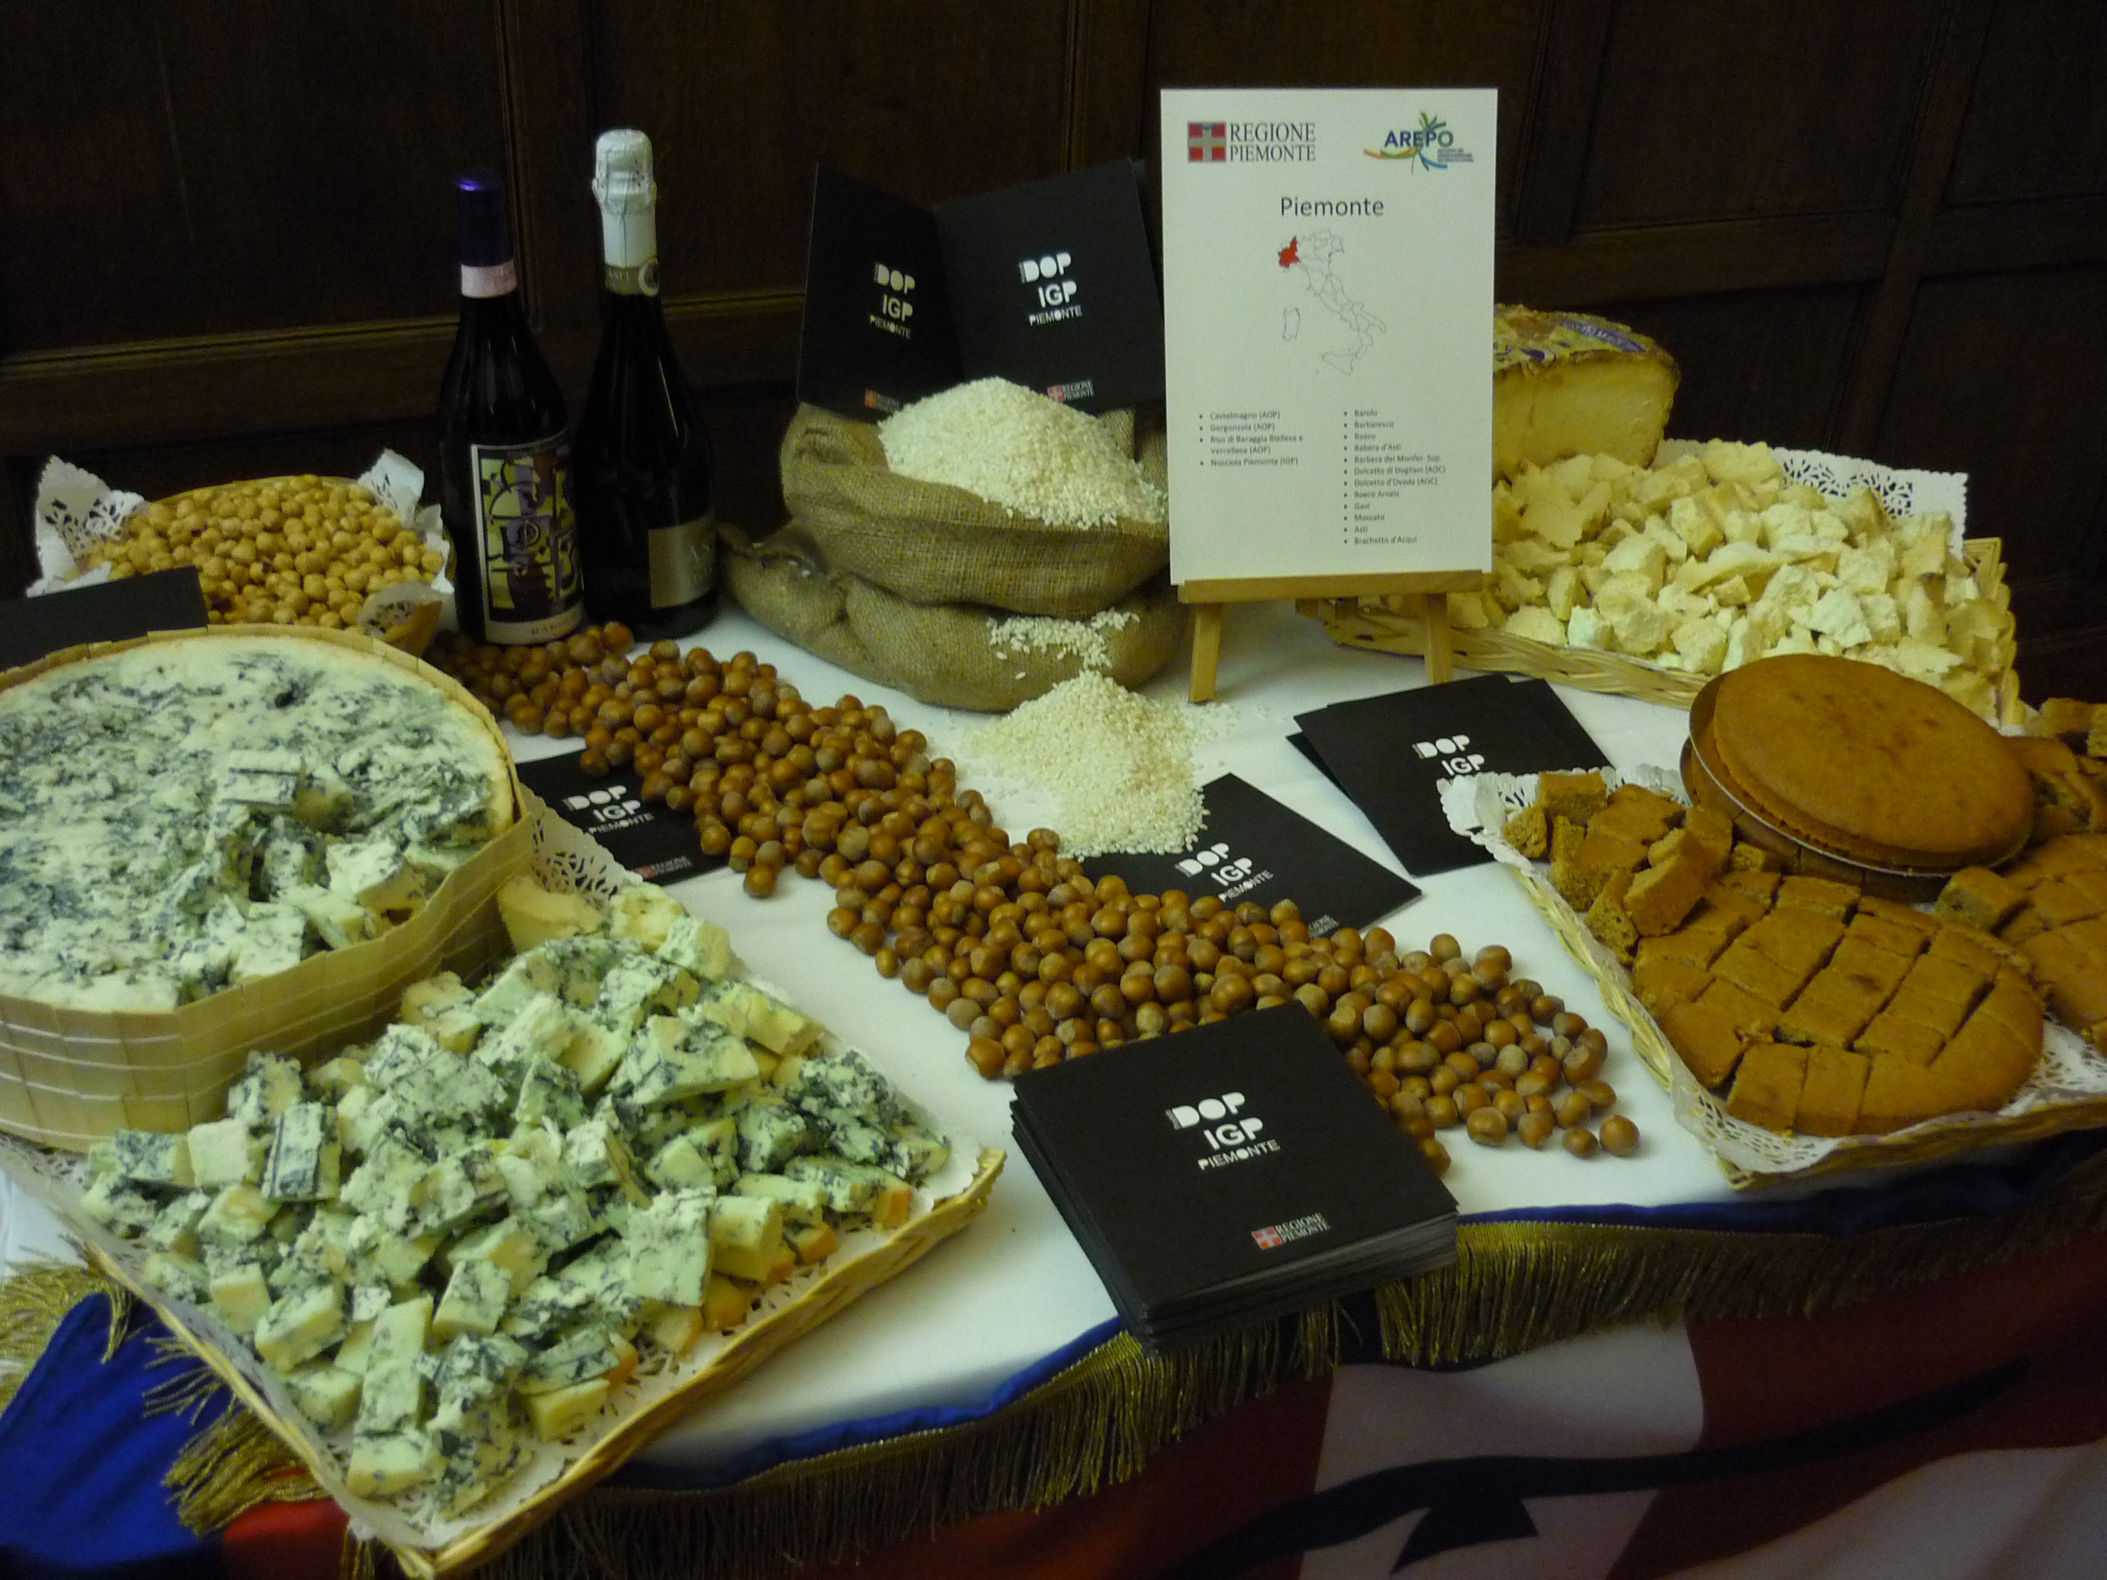
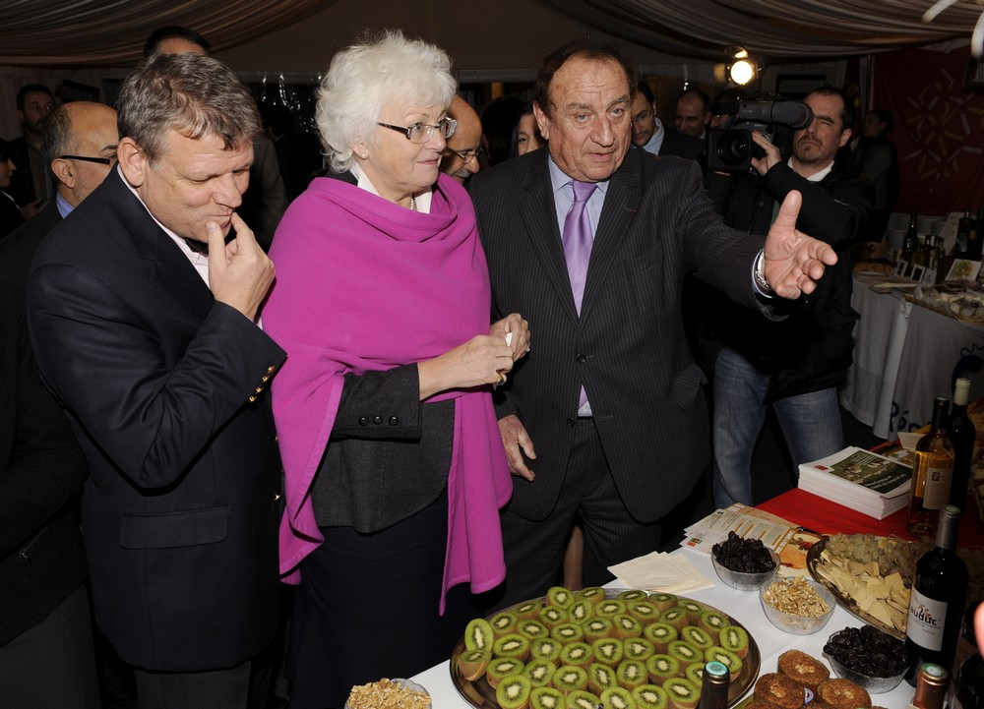
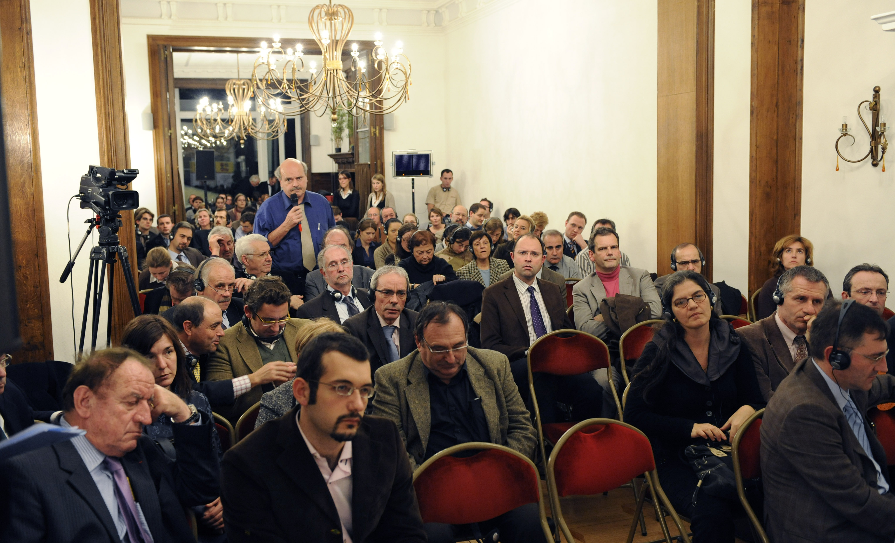
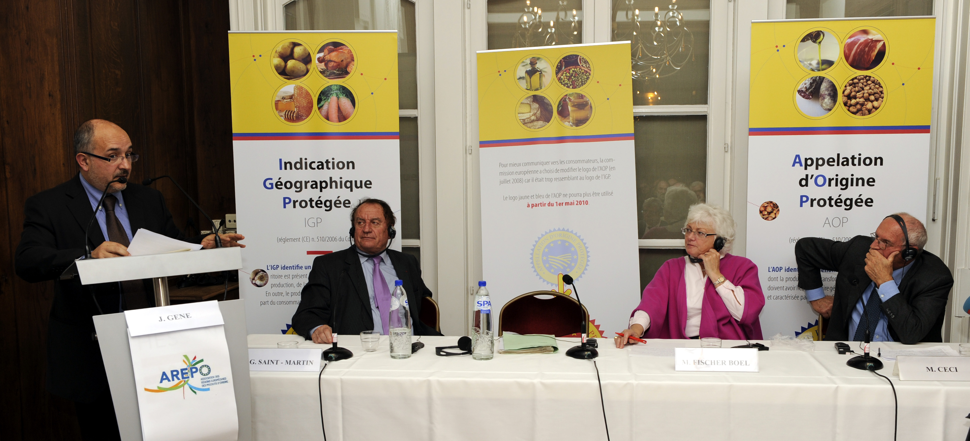
2009 - 1st EU event for the promotion of quality and origin products
2009 | 1st AREPO EU event
Main guest: Ms. Fischer Boel, European Commissioner for Agriculture
AGROSMARTglobal | Space for the competitiveness, promotion and intelligent international expansion of agri-food cooperatives in the Sudoe rural areas

Slide 8
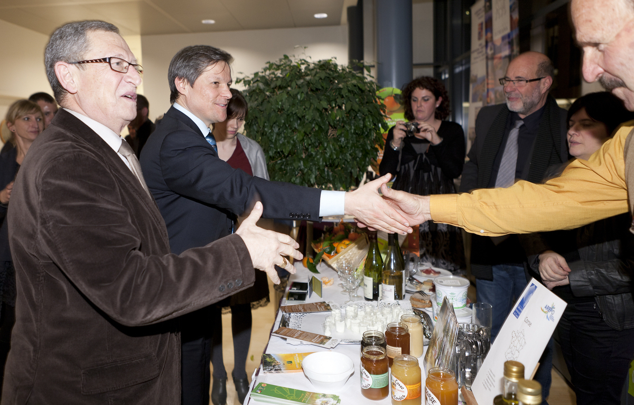
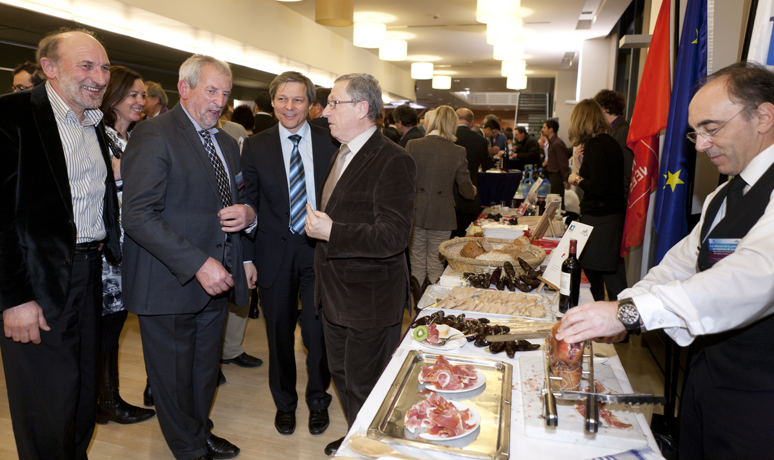
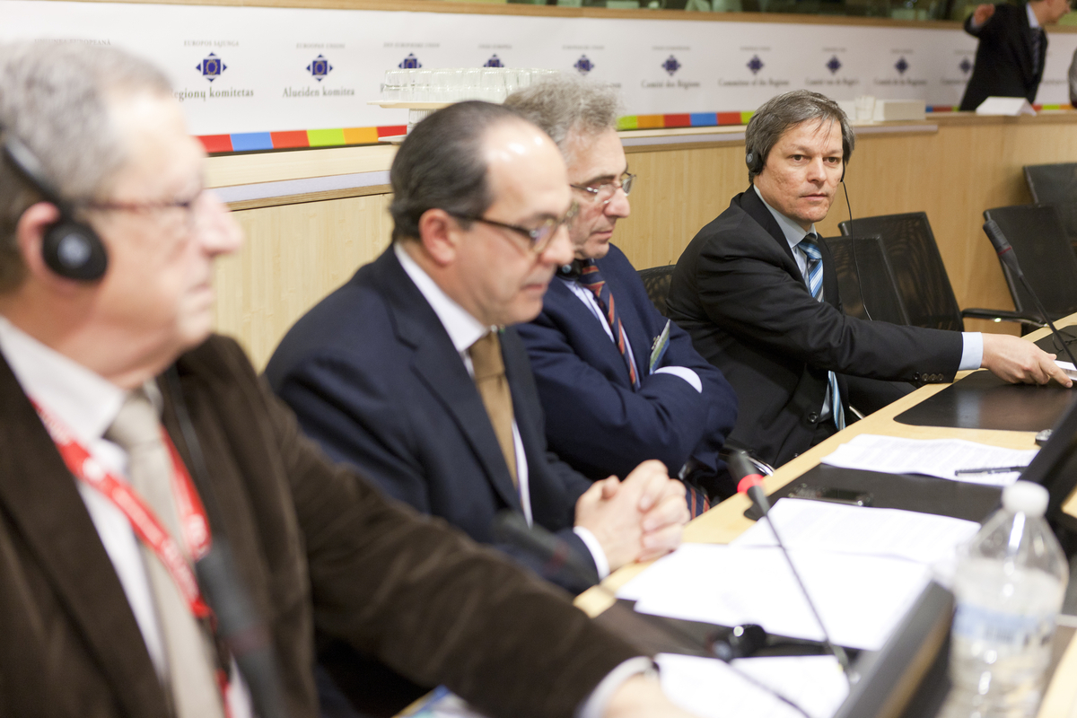
2011 | 2nd AREPO EU event
Main guest: M. Ciolos, European Commissioner for Agriculture
AGROSMARTglobal | Space for the competitiveness, promotion and intelligent international expansion of agri-food cooperatives in the Sudoe rural areas

Slide 9
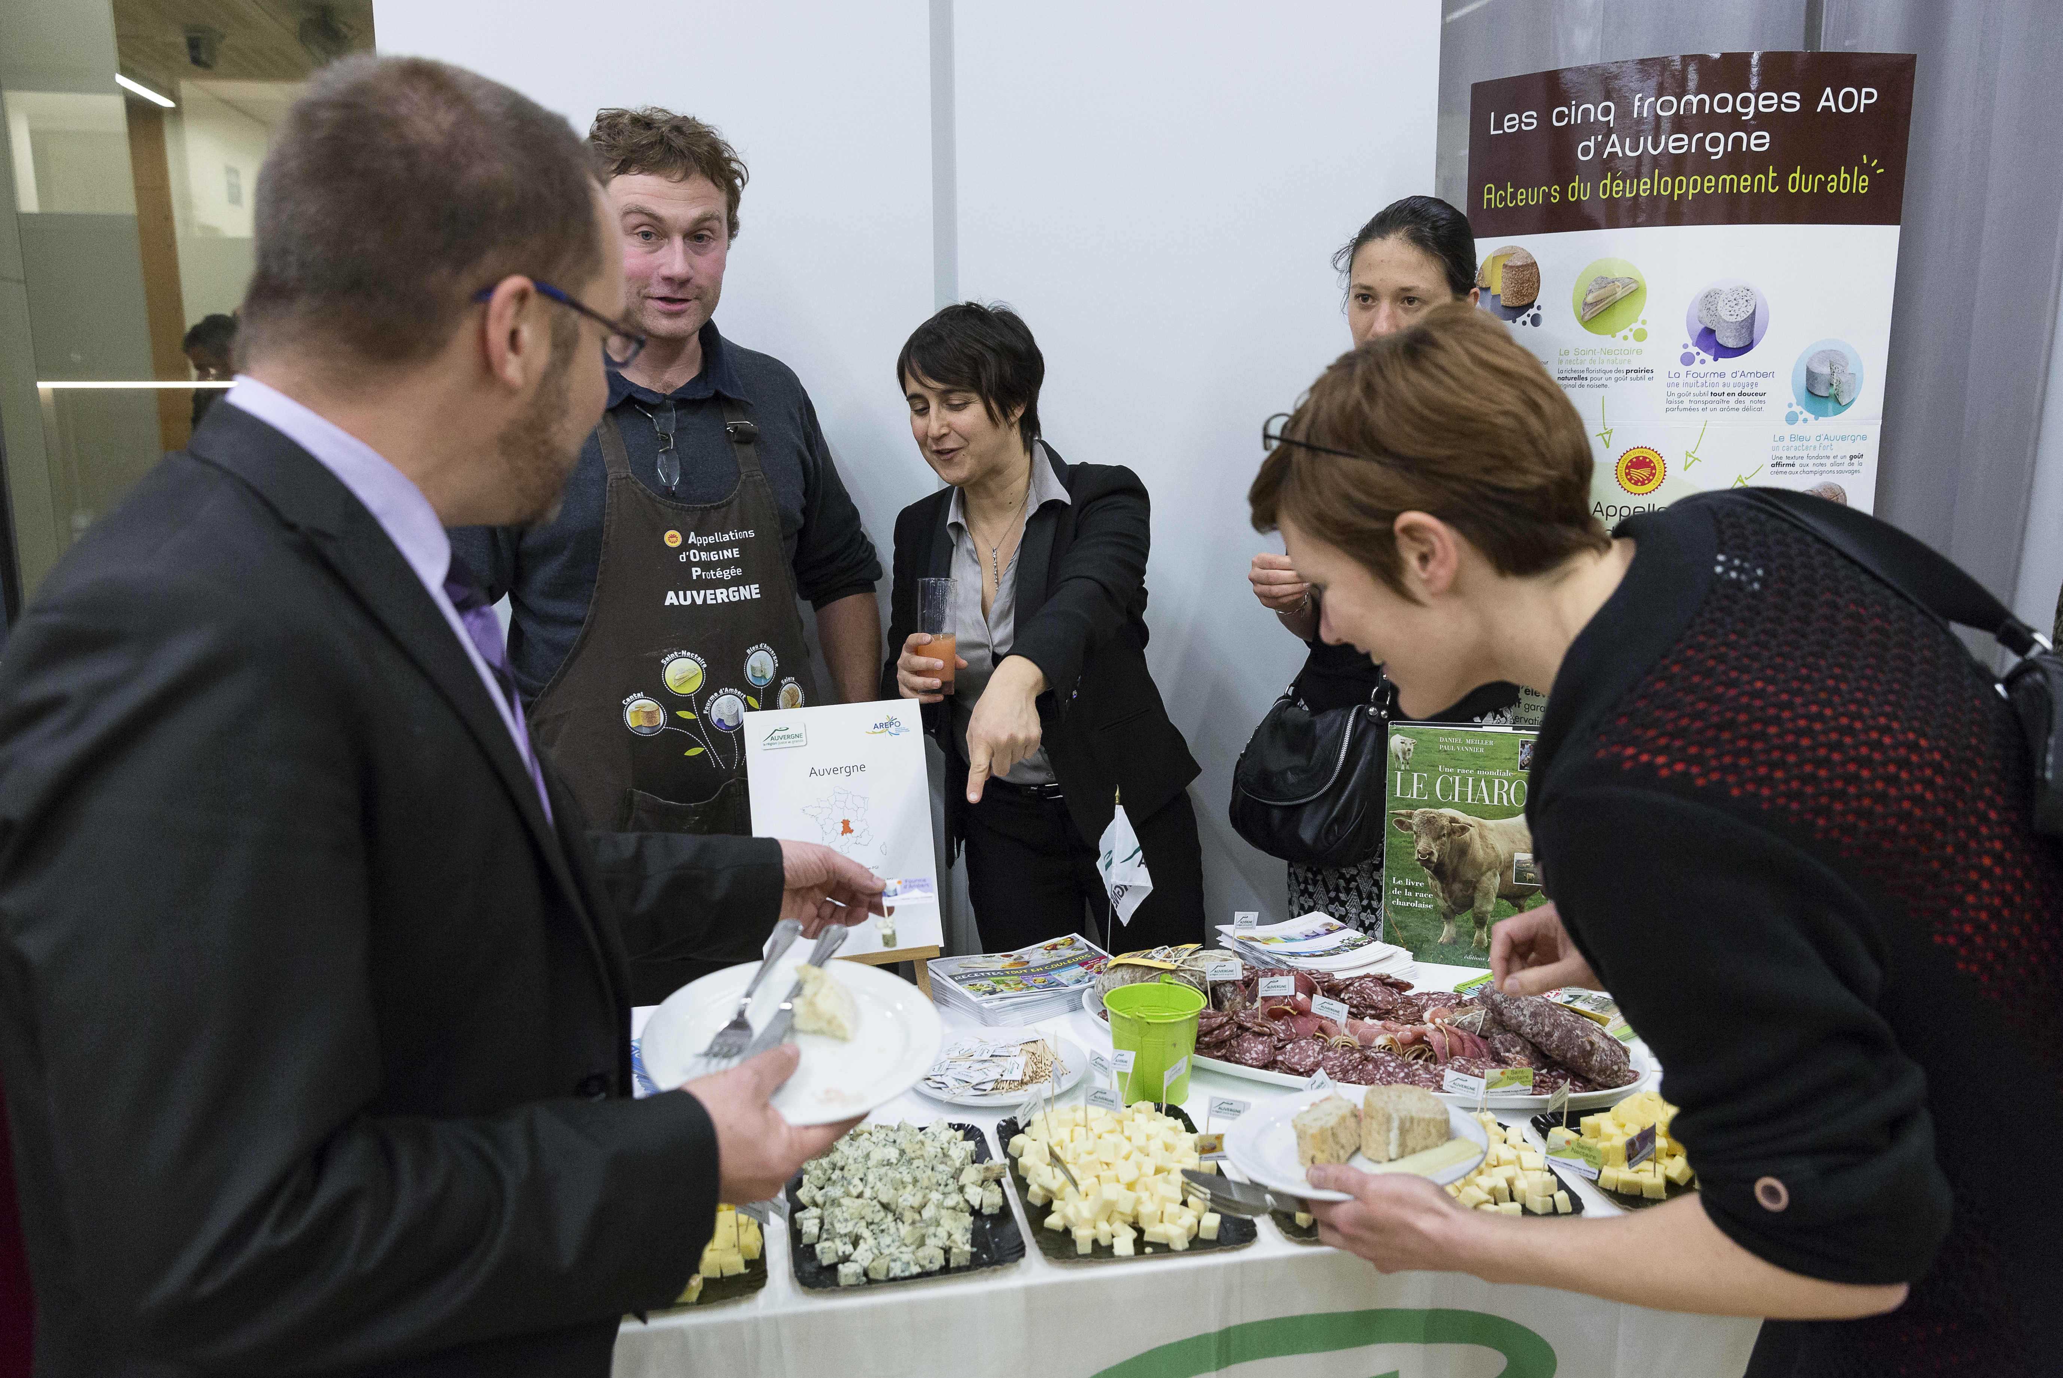
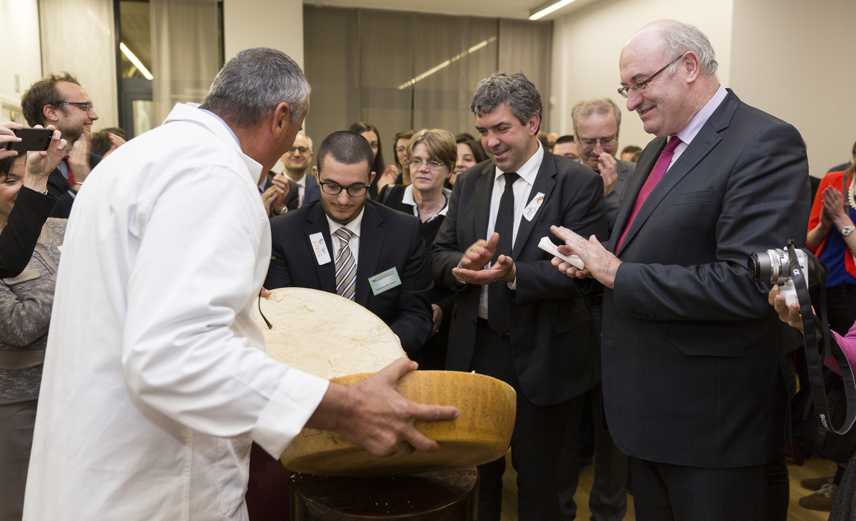
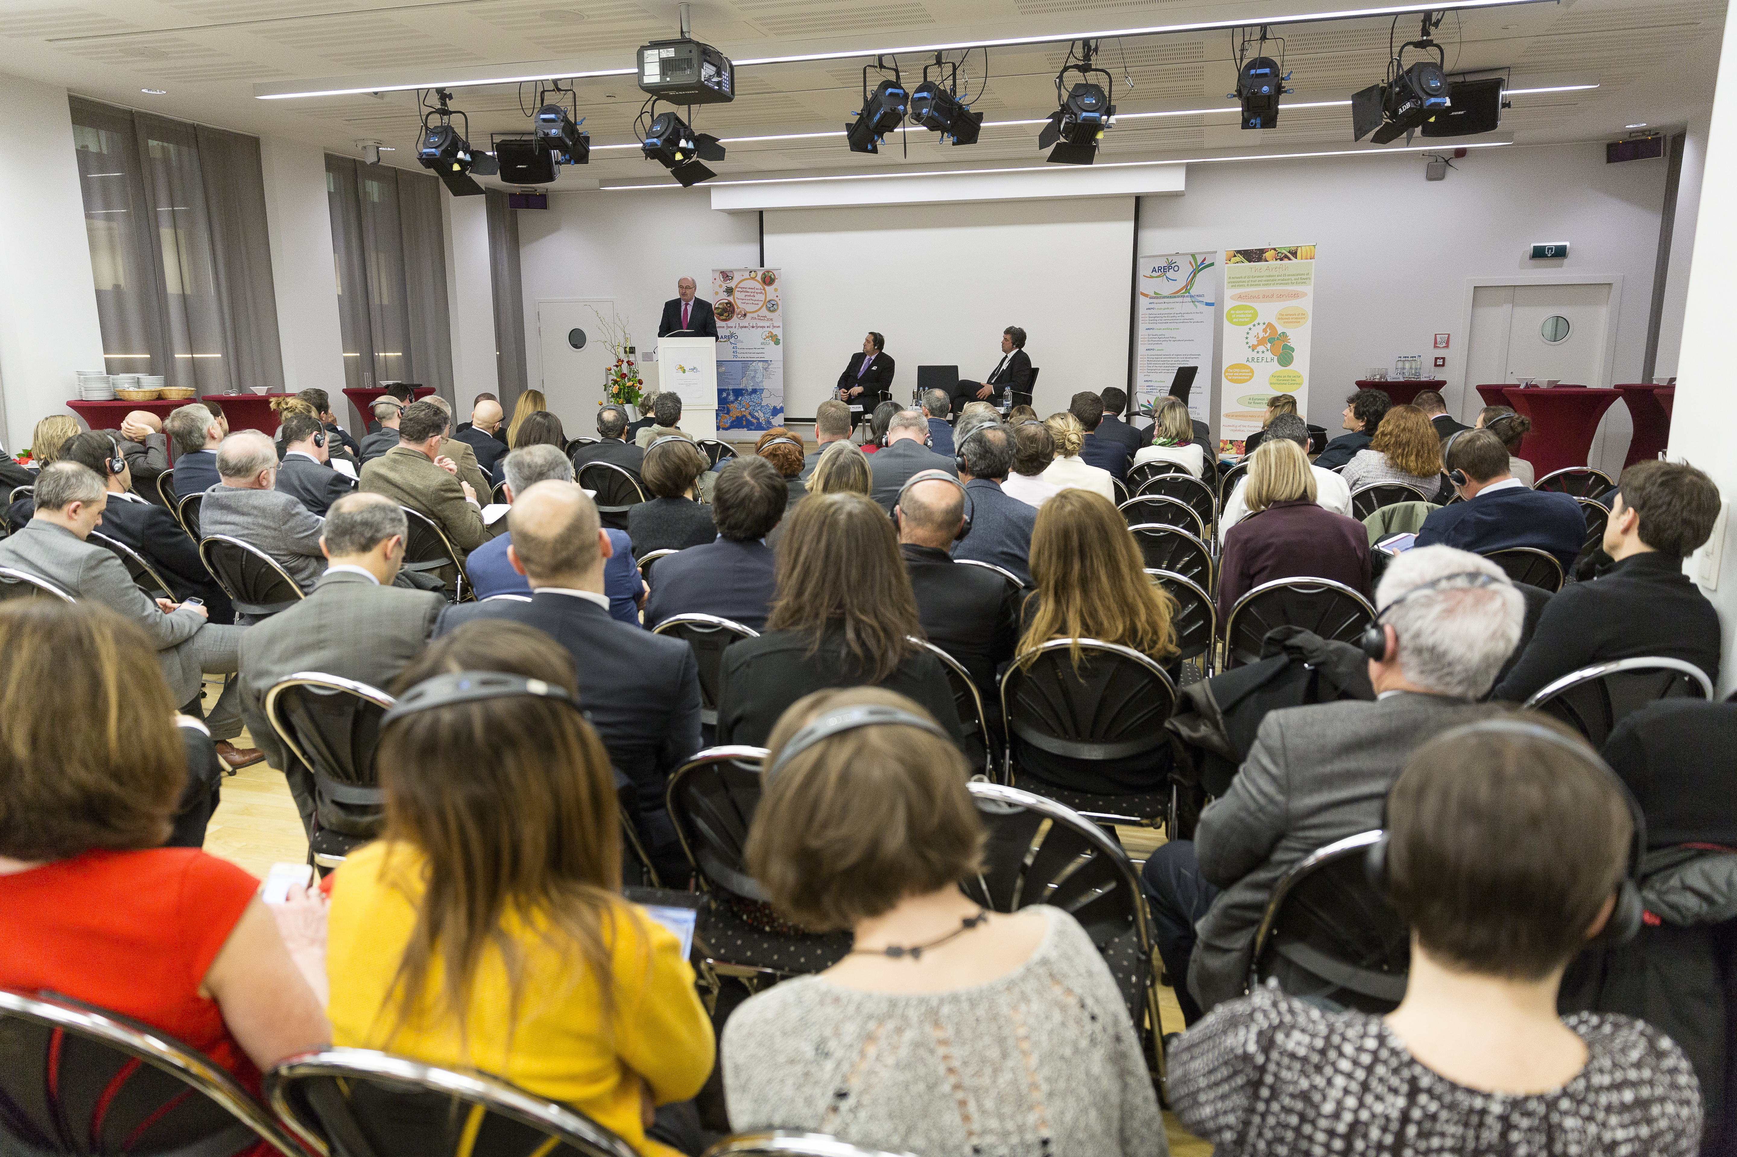
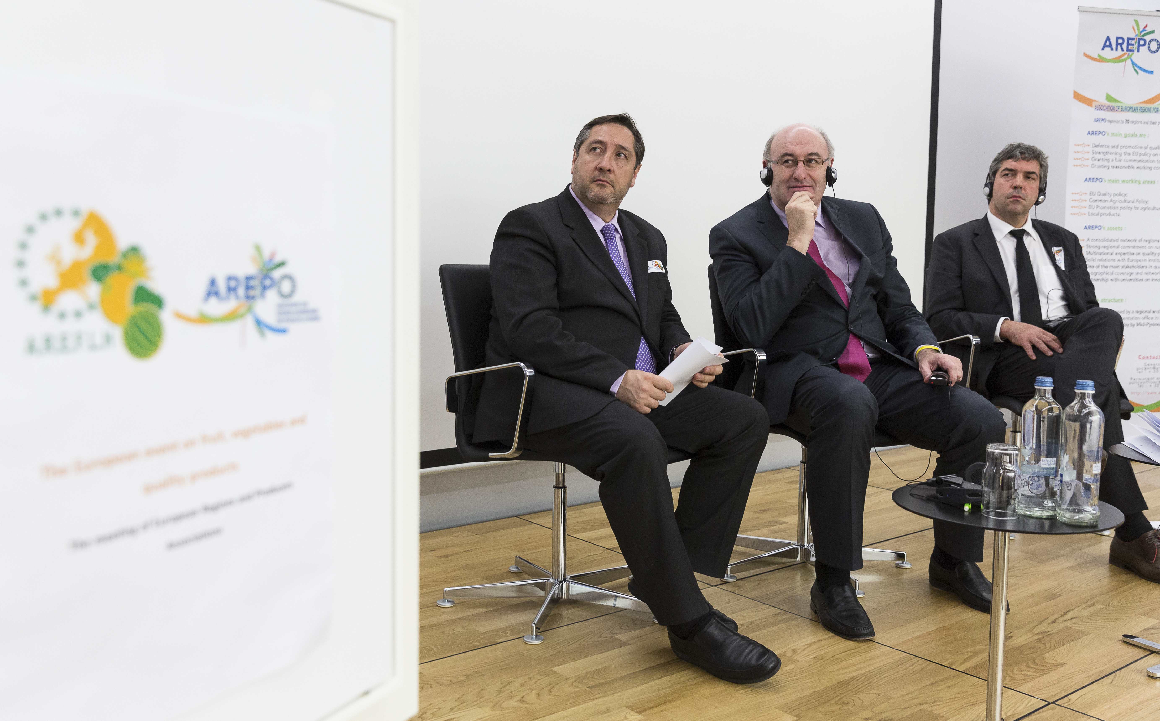
2015 | 3rd AREPO EU event
Main guest: M. Hogan, European Commissioner for Agriculture
AGROSMARTglobal | Space for the competitiveness, promotion and intelligent international expansion of agri-food cooperatives in the Sudoe rural areas

Slide 10
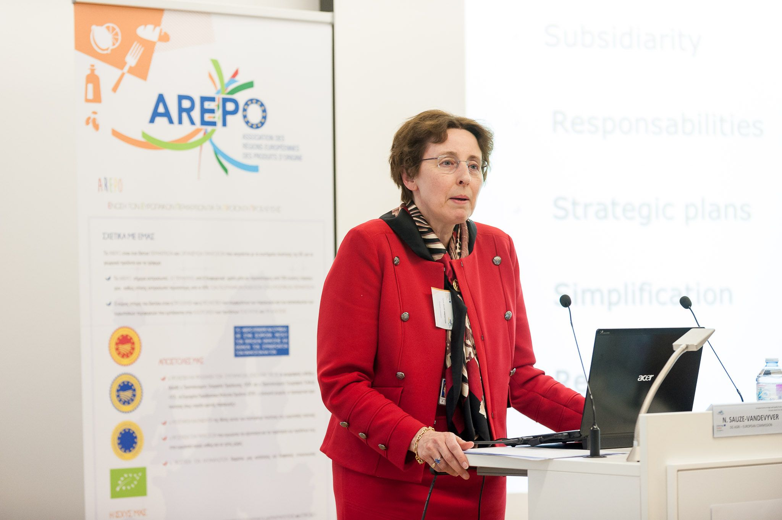
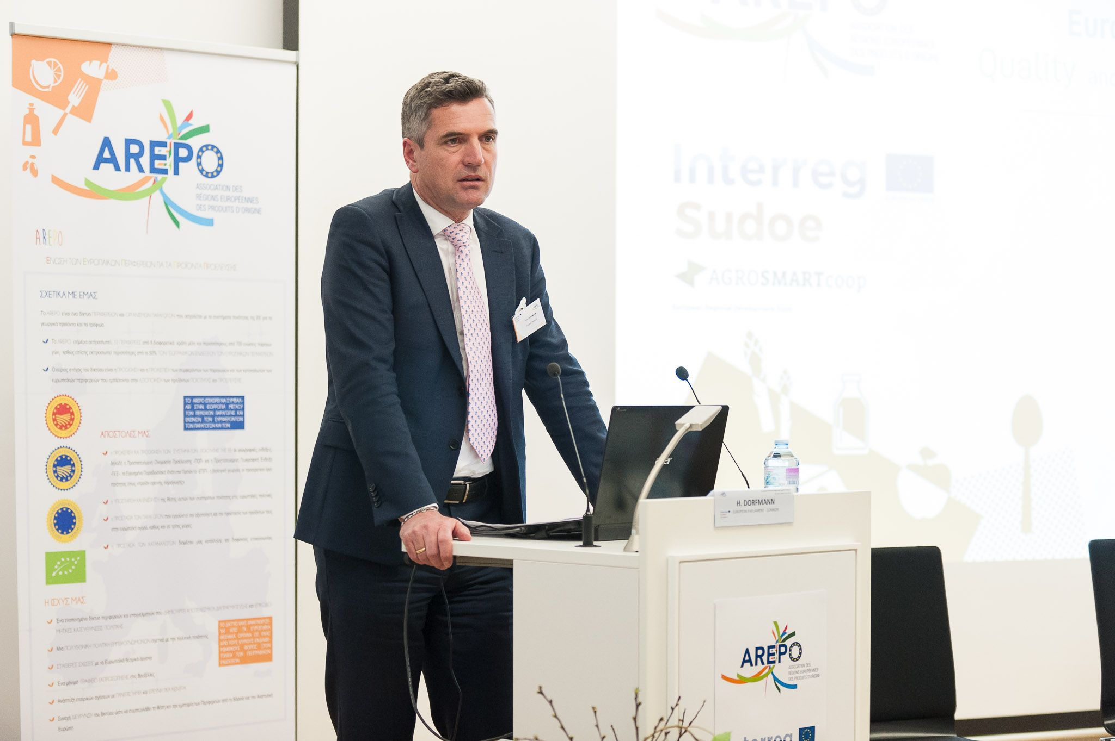
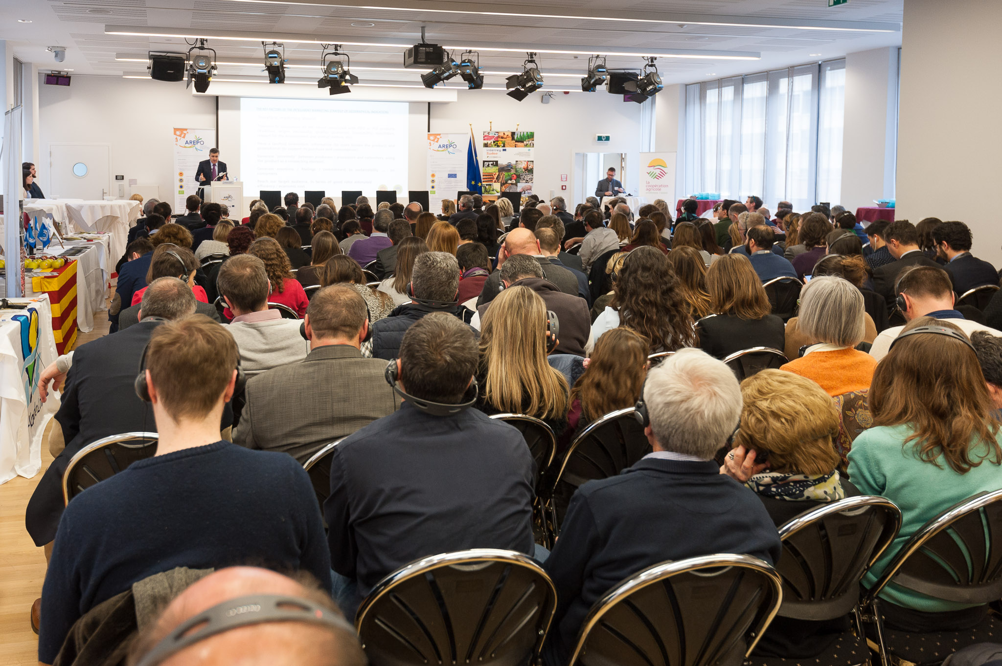
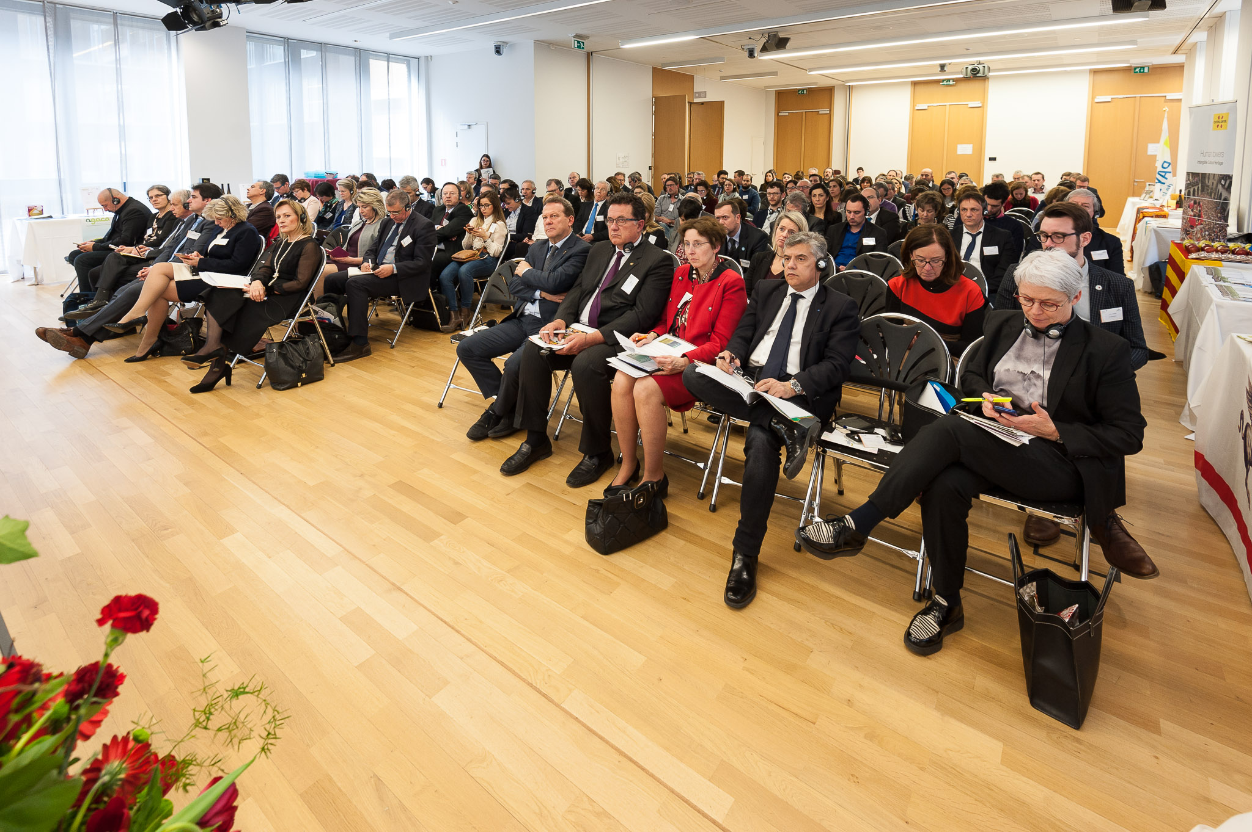
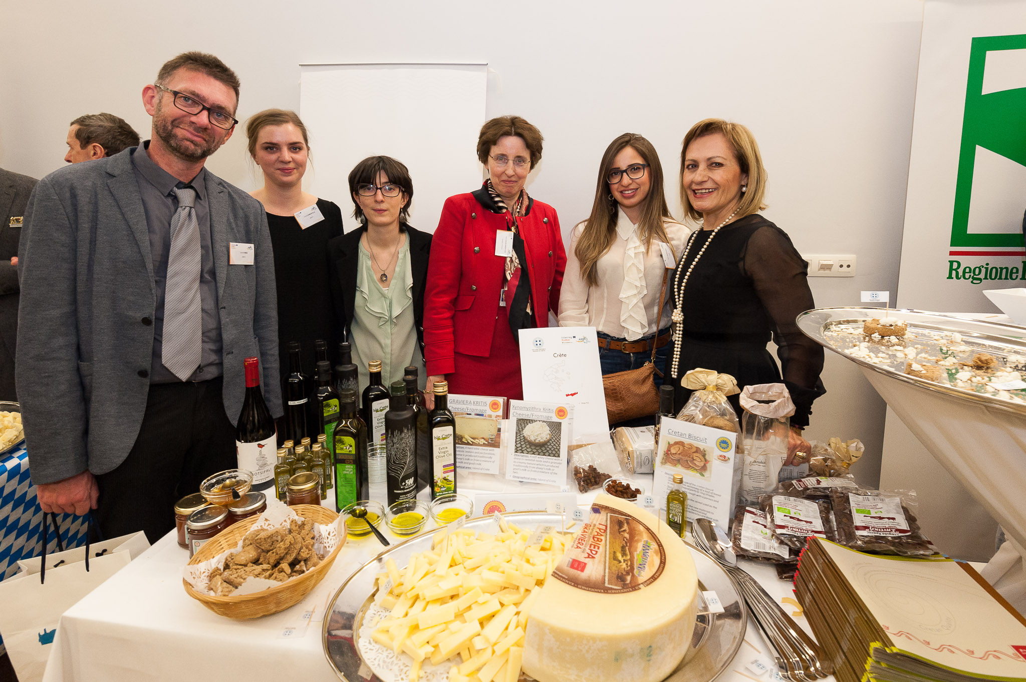
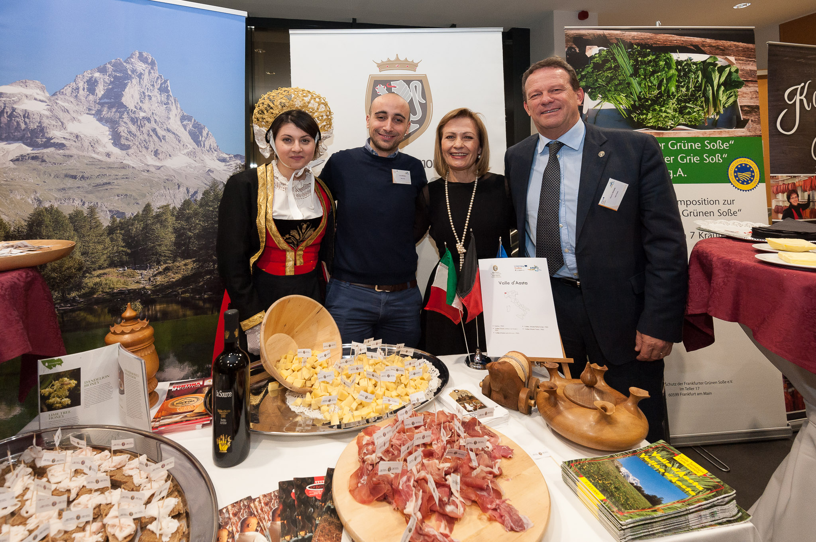
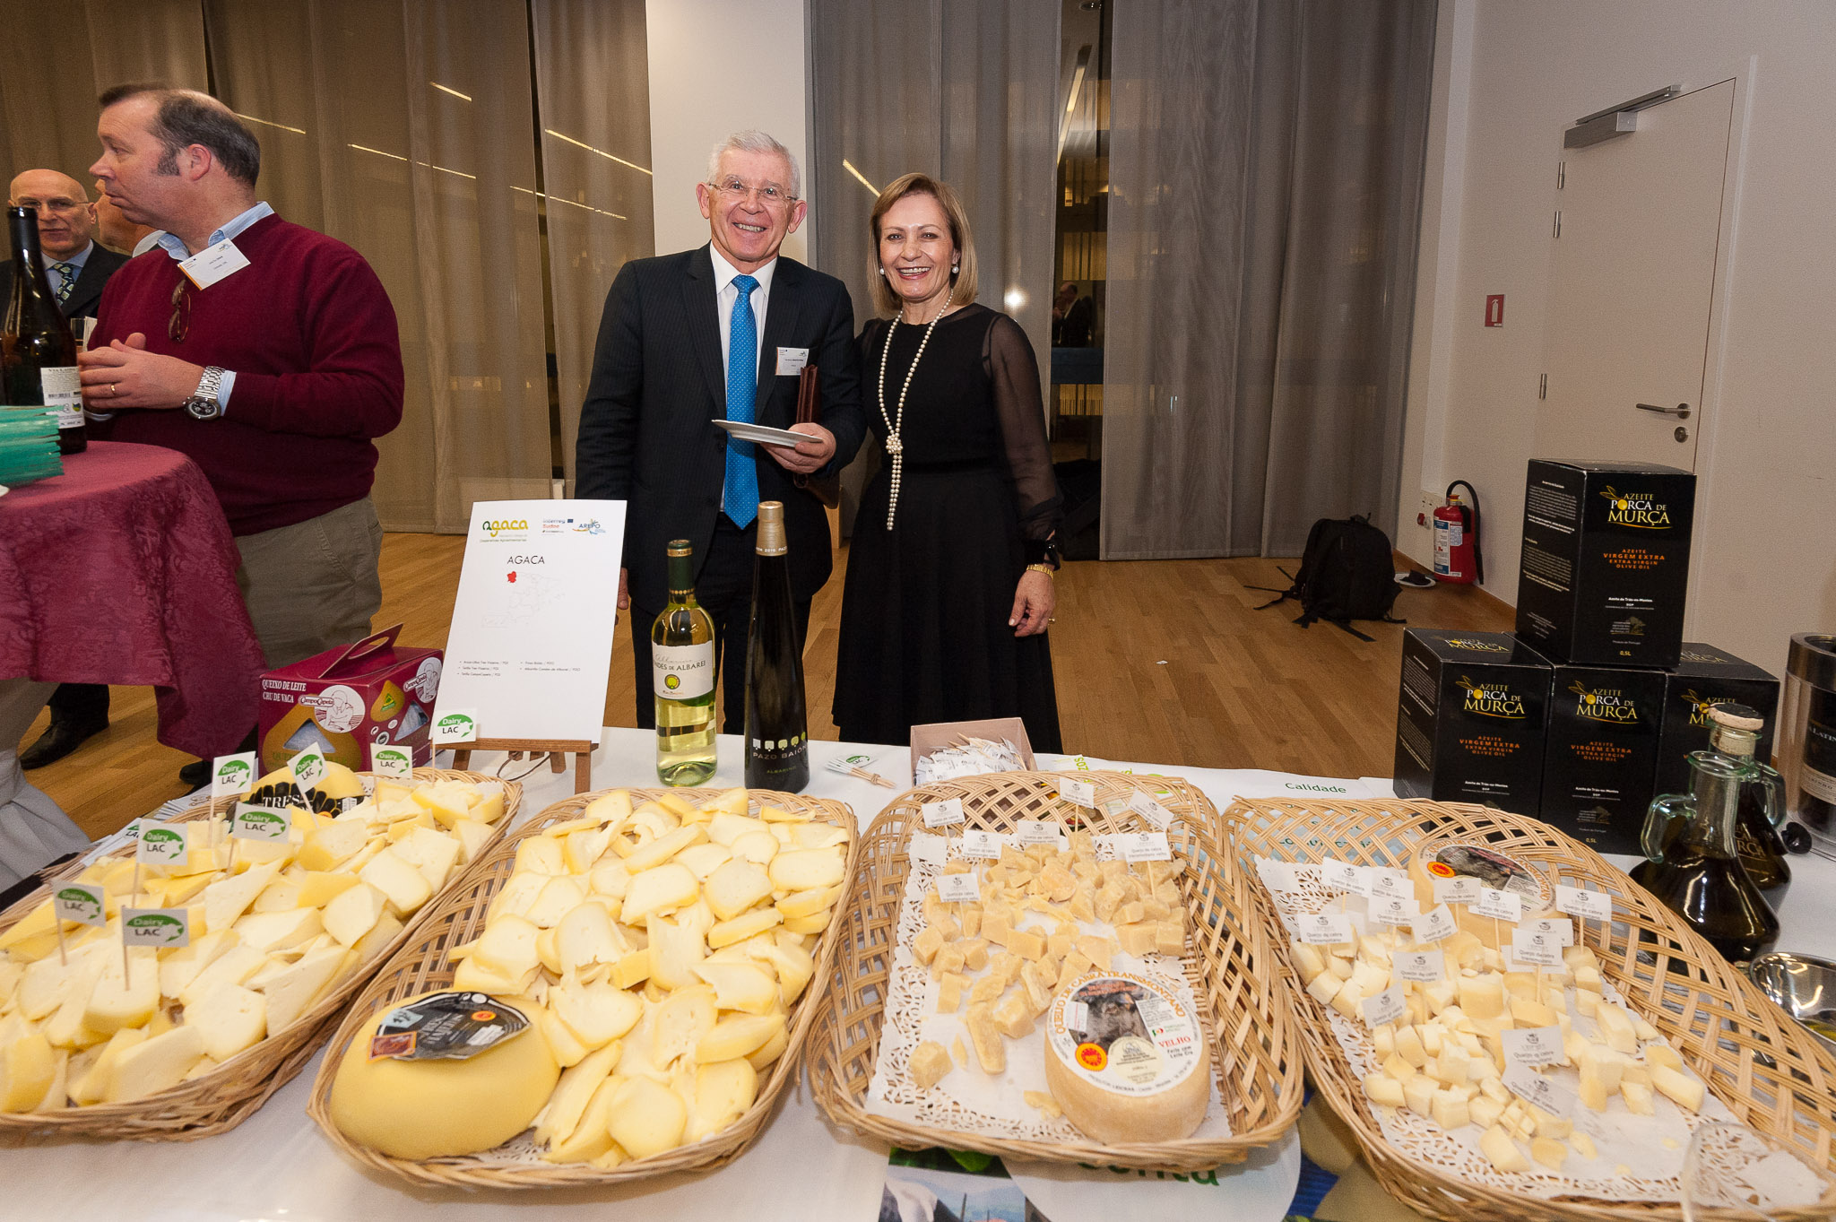
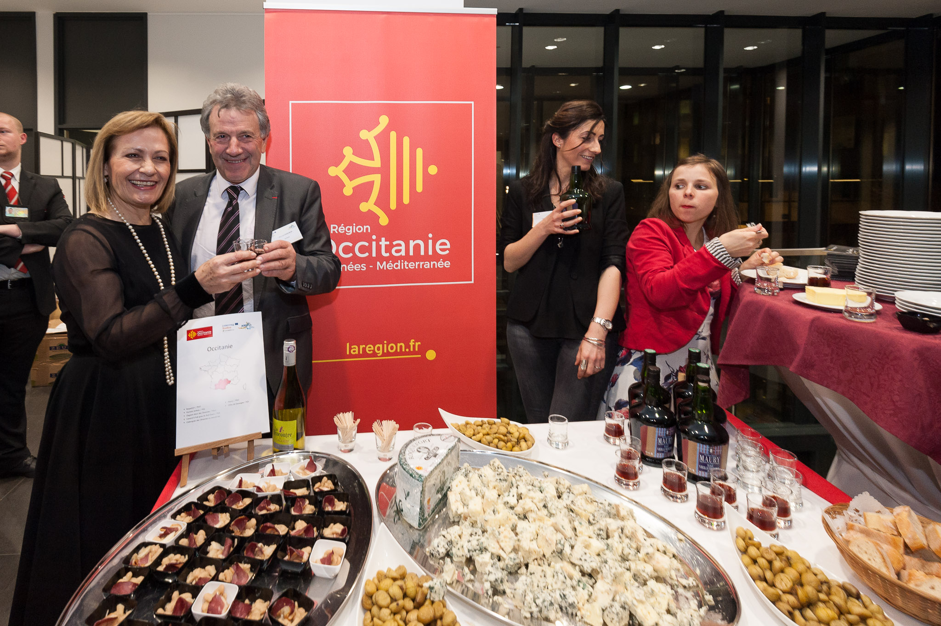
2018 | 4th AREPO EU event
Main guests: Ms. Sauze-Vandevyver, Director “Quality, Research & Innovation“
DG AGRI, European Commission
M. Dorfmann, MEP, Member of COMAGRI, Rapporteur on the Communication on “The Future of Food and Farming”
AGROSMARTglobal | Space for the competitiveness, promotion and intelligent international expansion of agri-food cooperatives in the Sudoe rural areas

Slide 11





Thank you for you attention!
For any questions, please, contact me here:
eu-projects@arepoquality.eu
https://www.agrosmartglobal.eu/
AGROSMARTglobal | Space for the competitiveness, promotion and intelligent international expansion of agri-food cooperatives in the Sudoe rural areas
The European Commission support for the production of this publication does not constitute endorsement of the contents which reflects the views only of the authors, and the Commission cannot be held responsible for any use which may be made of the information contained therein.

